Slide 1
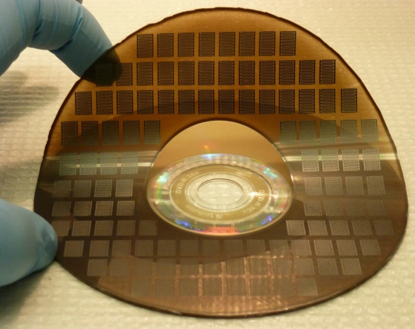
New Energy Storage Medium Could Possibly Replace Battery
Competitive or better than current battery life.
Non-toxic and biodegradable
Extremely cheap
Easily produced with common tools
2/21/13

